Slide 1
Lecture 31 – Introduction to Dynamic Programming
CST370 – Design & Analysis of Algorithms
Dr. Byun
Computer Science

Slide 2
Lecture Objectives
After completion of this lecture, you will be able to
  describe basic ideas of dynamic programming.
  apply the dynamic programming technique to solve a coin-row problem.

Slide 3
Dynamic Programming
Dynamic programming is a general algorithm design technique for solving a problem with overlapping subproblems.
  It’s invented by Richard Bellman in the 1950s.
  Here, “programming” means “planning”.
A problem to be solved in dynamic programming is typically defined by a recurrence relation.

Slide 4
Example – Fibonacci Numbers
F(0) = 0
F(1) = 1
F(n) = F(n-1) + F(n-2) for n >= 2

Slide 5
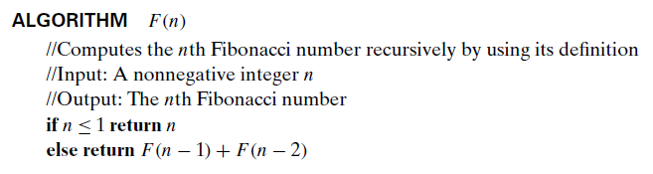
Computing F(n): Brute-Force Approach
To calculate the Fibonacci number, F(n), for an integer n, we can use a brute-force approach of the following pseudo-code.
  Note that we use a recursive function in it.

Slide 6
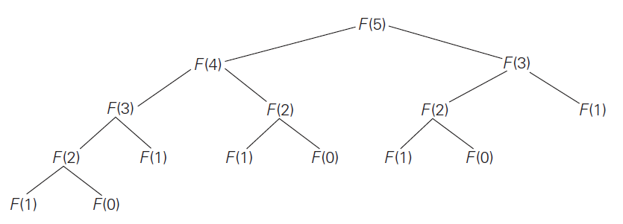
Computing F(n): Brute-Force Approach
A drawback of the recursive algorithm is that we have too many overlapped function calls.
  For example, if we call F(5), the algorithm must calculate F(0) three times and F(1) five times.

Slide 7
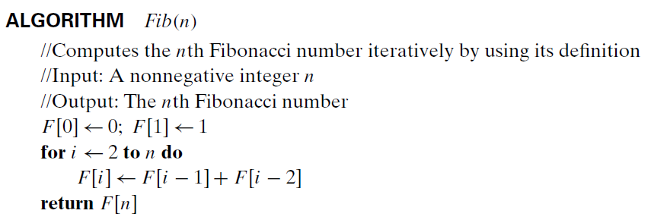
Computing F(n): Dynamic Programming
We can compute F(n) using “iteration and record (= dynamic programming)” approach.
  To avoid multiple calls for a subproblem, we use an array to keep solutions of subproblems.
  Pay attention to the “for” loop in the code.

Slide 8
Computing F(n): Dynamic Programming
Watch this video first
  https://youtu.be/Z161TwNMqNE (2:50)
Recurrence, F(n), for Fibonacci numbers
  F(0) = 0
  F(1) = 1
  F(n) = F(n-1) + F(n-2) for n >= 2
Example: F(5)
F(0)
F(1)
F(2)
F(3)
F(4)
F(5)

Slide 9
Dynamic Programming – Basic Approach
Set up a recurrence relation that describes a solution to a problem with smaller sub-problems.
Solve the smaller sub-problems and record the solutions in a table.
Solve the original problem using the table.

Slide 10
Chapter 8: Dynamic Programming
8.1 Three Basic Examples
8.2 The Knapsack Problem and Memory Functions
8.3 Optimal Binary Search Trees
8.4 Warshall’s and Floyd’s Algorithms

Slide 11
Coin-Row Problem
Given n coins with the values of c₁, c₂, c₃, …, c_{n}, pick up the maximum amount.
Constraint: No two coins adjacent can be picked up.

Slide 12
Example

Slide 13
Recurrence Relation of Coin-Row Problem
Let F(n) be the maximum amount for n coins.
  F(0) = 0
  F(1) = c₁
For a general number n, we can have only two cases.
  Solution with the last coin
  Solution without the last coin
F(n) = max {F(n-2) + c_{n}, F(n-1)} for n > 1

Slide 14
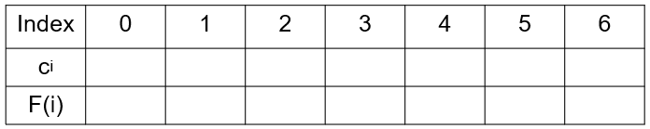
Example
5, 1, 2, 10, 6, 2
F(0) = 0
F(1) = c₁
F(n) = max {F(n-2) + c_{n}, F(n-1)} for n > 1

Slide 15
Analysis

Slide 16
Exercise
3, 2, 3, 2, 1, 2
Index | 0 | 1 | 2 | 3 | 4 | 5 | 6
c_{i}
F(i)

Slide 17
Resources
Read the following document and understand the basic idea to solve the coin-row problem.
  https://goo.gl/7LS6ZN
Video for the coin-row problem.
  https://goo.gl/9WSRNs

